Slide 1
Southfork of the Spring River Sub-Watershed Project
(11-1200)
Fulton County Conservation District Arkansas Natural Resource Commission
U S Environmental Protection Agency

Slide 2
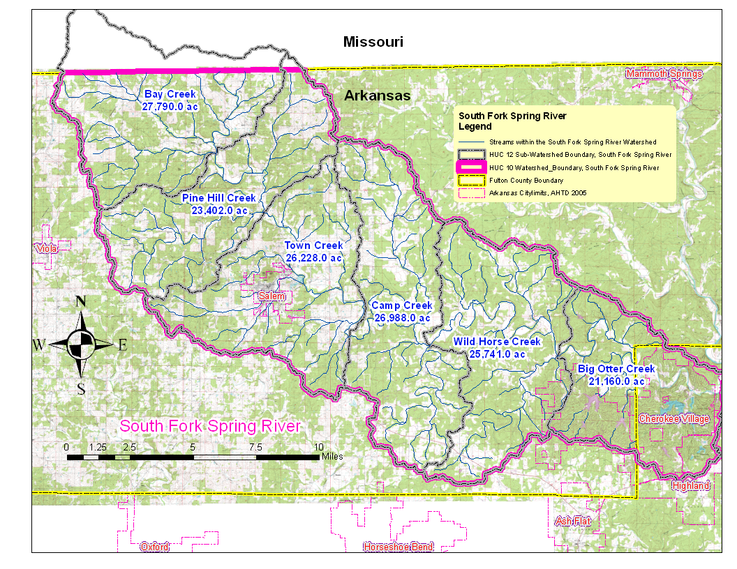

Slide 3
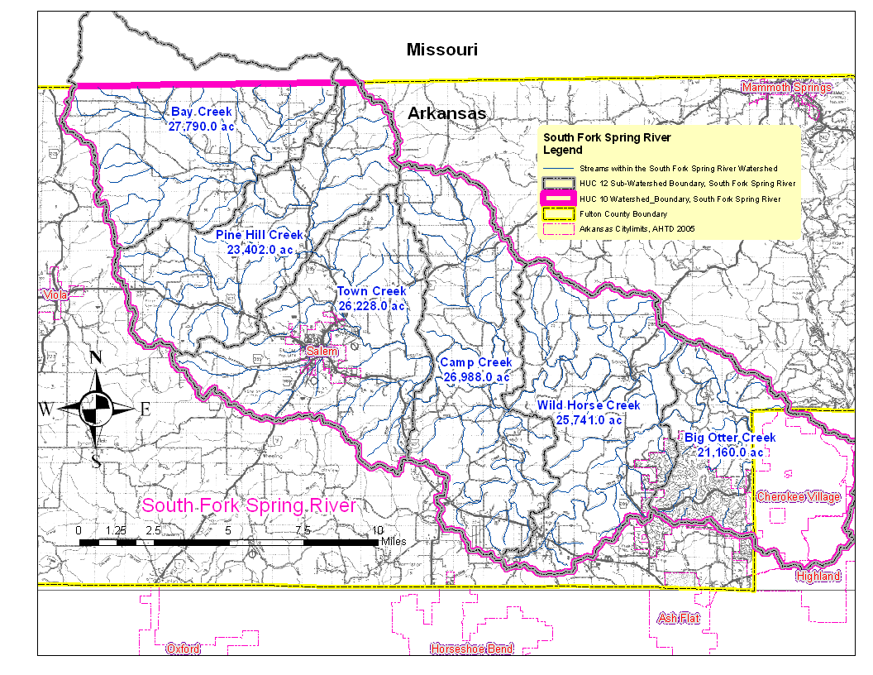

Slide 4
Priorities for Planning
Farms that are within or partially within a wellhead protection area.
All farms with riparian access along blue line streams as indicated on the 7.5 minute USGS quadrangle maps.
All farms within 1 Mile of a blue line stream.

Slide 5
Objectives
The primary objective is to maintain or restore
all designated uses of the Southfork of the
Spring River Sub Watersheds Project by:
Implementing a program that will bring about VOLUNTARY participation of landowners in the application of the necessary BMP’s.
Implementation of 150 conservation plans on 48,000 acres of pastureland and 6.5 miles of stream bank protection.

Slide 6
Promoting and measuring the receptiveness of landowners in the project area to the transfer of poultry litter from nutrient surplus areas to areas where the litter will result in improved ground cover decreasing sedimentation.
Conservation planning and financial assistance to implement BMP’s will result in the establishment of vegetative cover on the pastureland.

Slide 7
Getting the word out
Word of mouth
Newsletter
Annual Central Ozarks Grassland Conference
Equipment Rentals
Newspaper
Television
Coffee shop
Field days

Slide 8
Recommended practices for implementation
Fence
Well
Pond
Watering facility
Pipeline
Pasture planting
Brush and weed control
Critical area planting
Stream bank and shoreline protection
Animal waste system
Spring development
Heavy use area
Riparian forest buffer

Slide 9
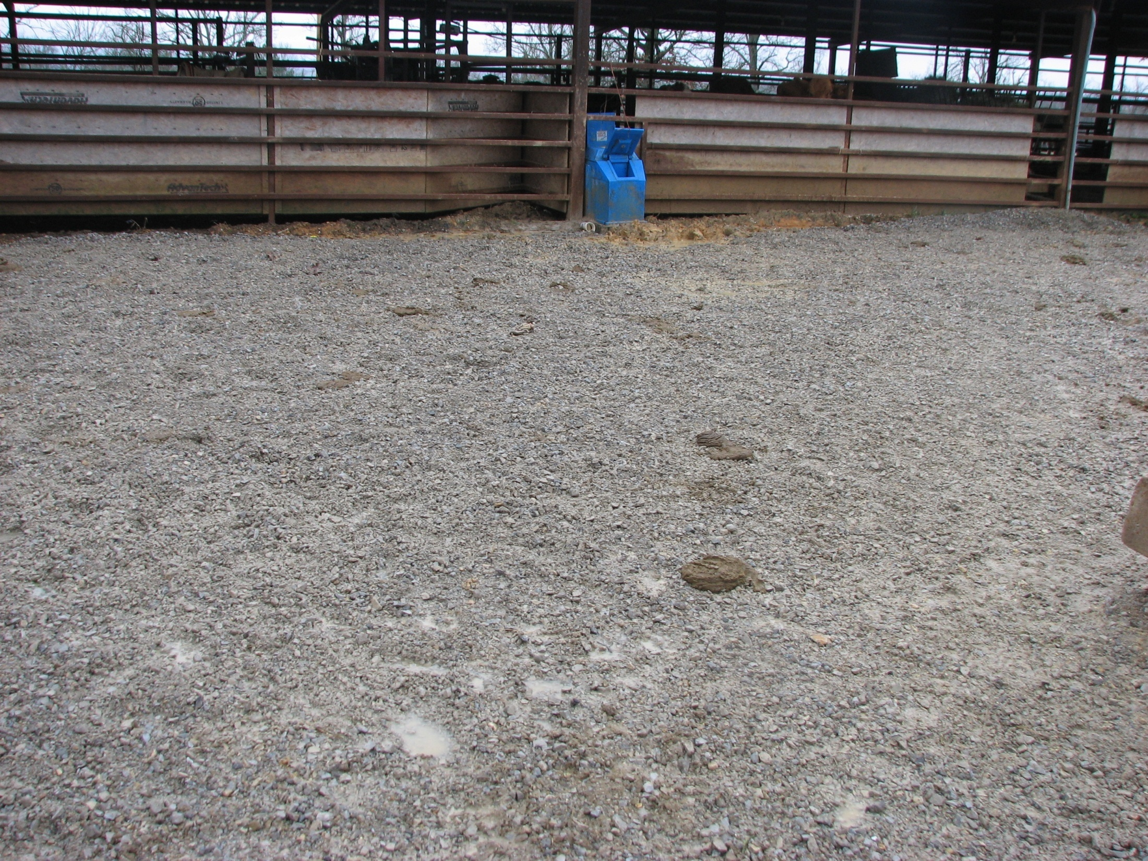
Notes:
(561) Heavy use area
(614) Double ball watering facility

Slide 10
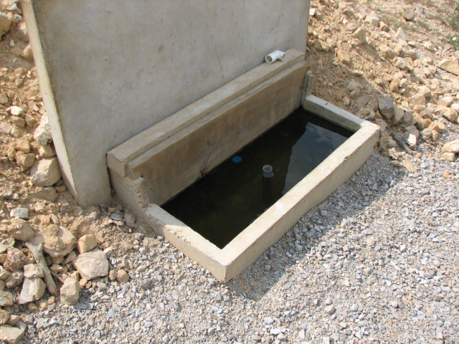
Notes:
Freeze proof tank

Slide 11
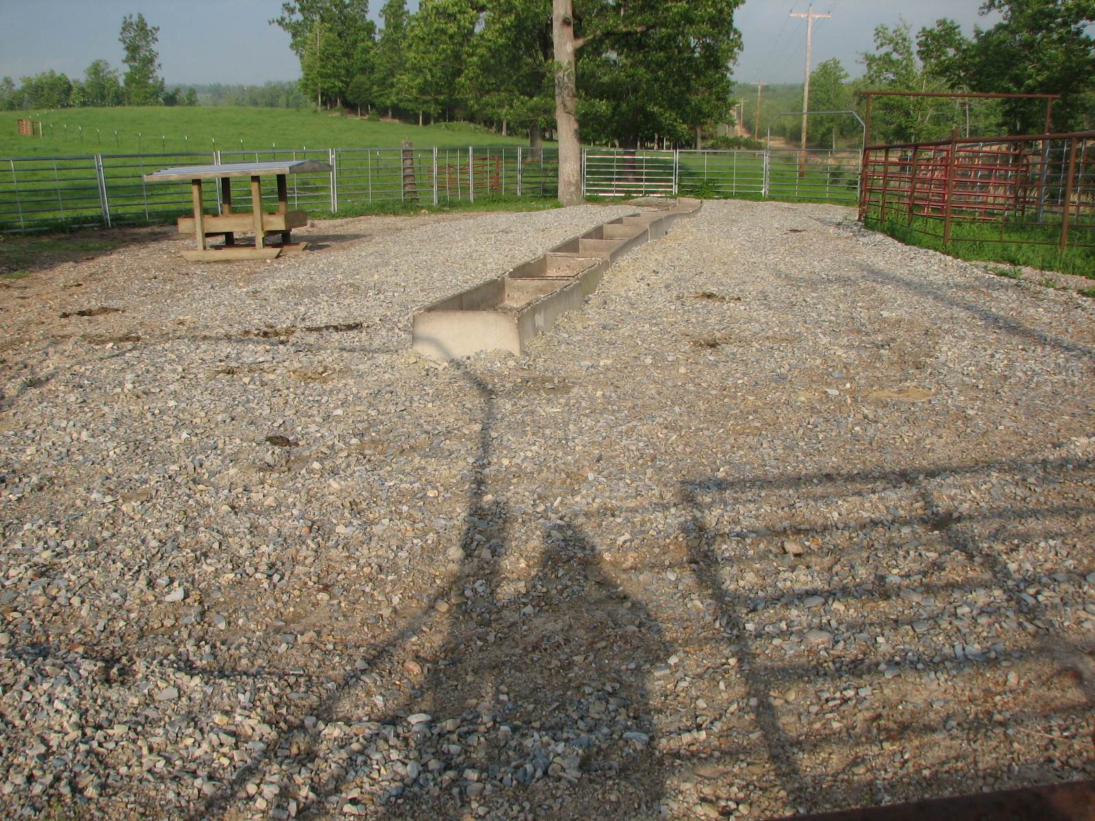

Slide 12
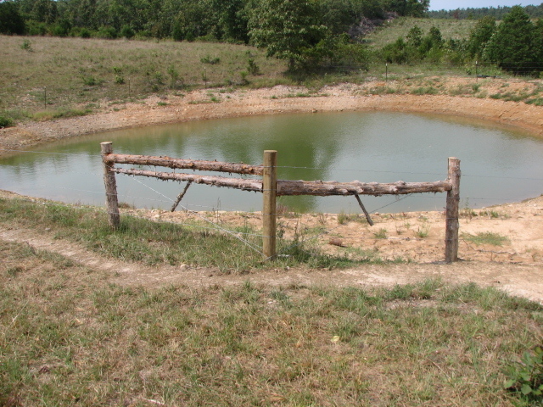
Notes:
(378) Pond
(382) Fence to exclude livestock

Slide 13
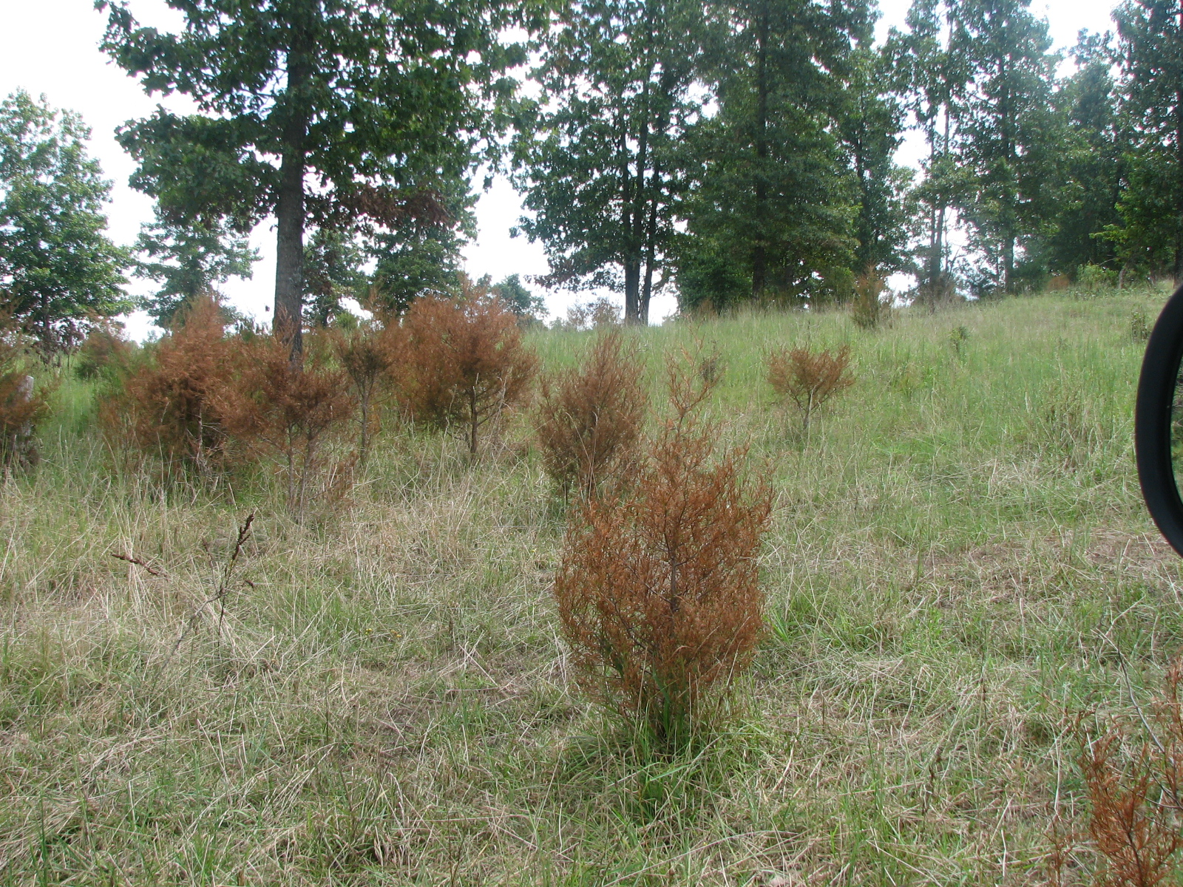
Notes:
(314) Brush management

Slide 14
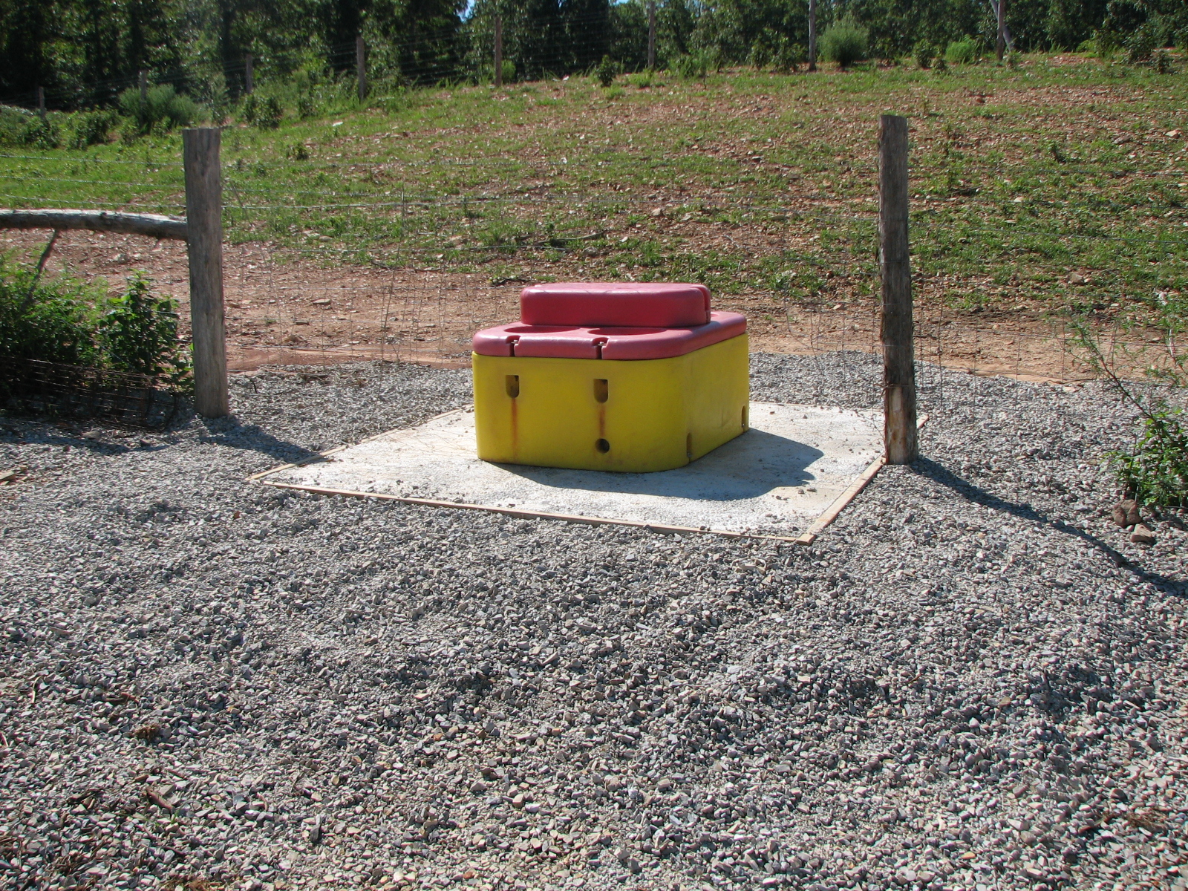
Notes:
(614) Watering facility- off of the well
(516) Pipeline
(561) Heavy use area

Slide 15
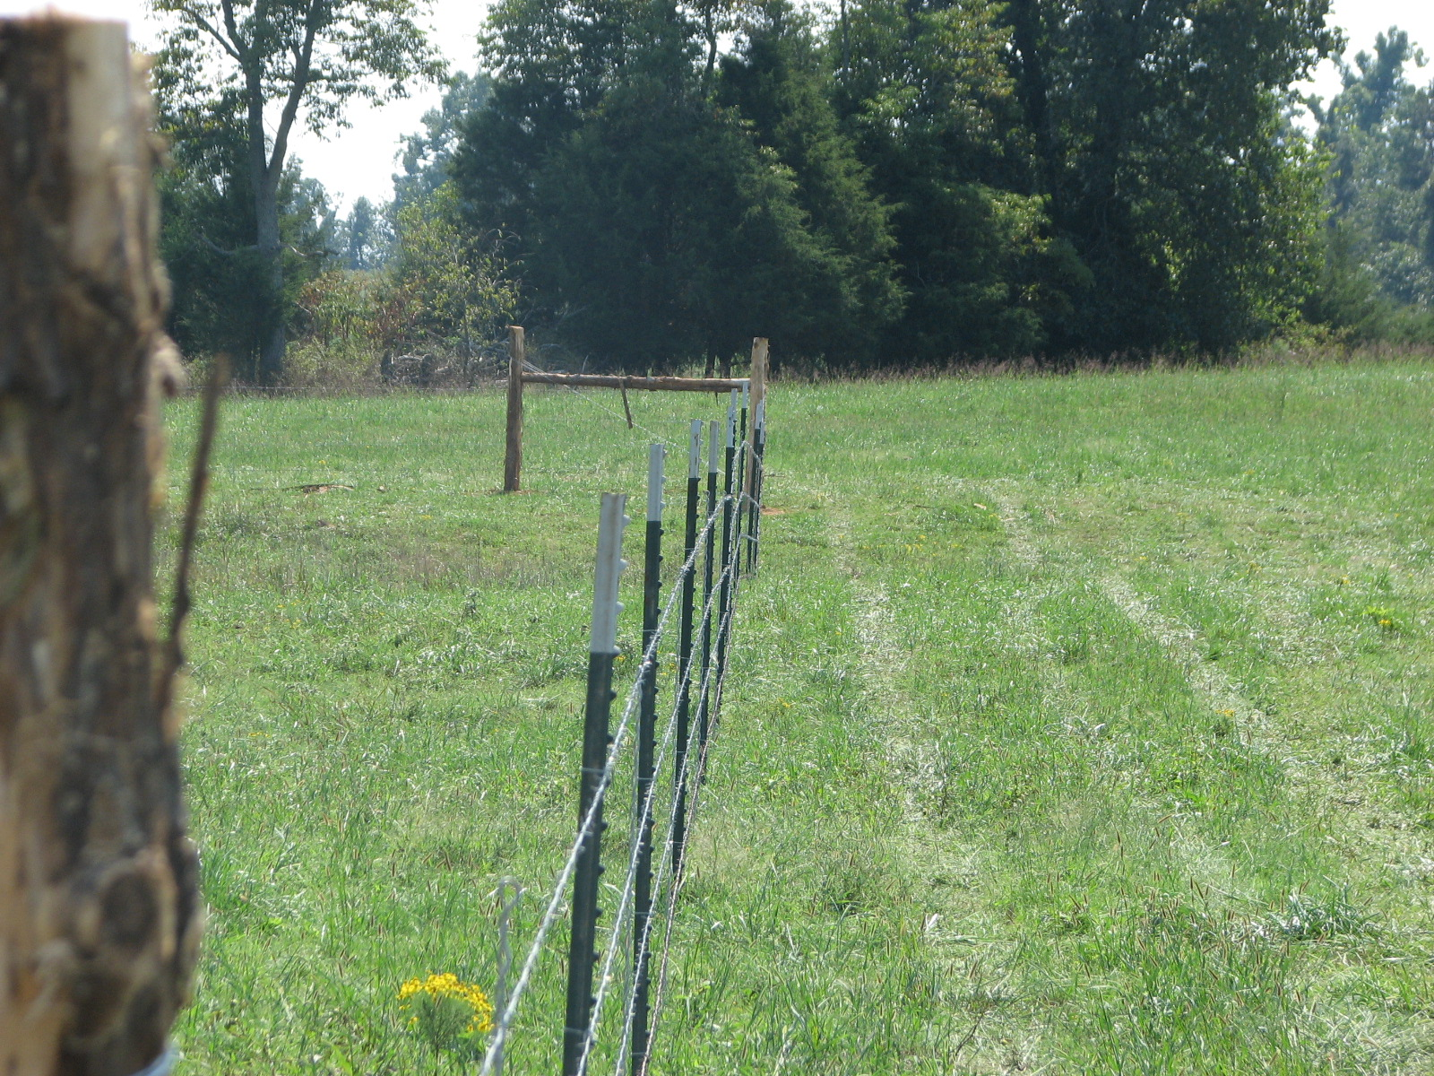
Notes:
(382) Cross fence

Slide 16
BMP’s Installed
Pasture and Hayland Planting (512)……313.4 acres
Fence (382)…………………………………18,352.8 ft
Watering Facilities (614)………………………….6 ea
Heavy Use Area Protection (561)………….... .05 ac
Brush Management (314)……………………...684 ac
Pond (378)………………………………………..…1ea
Pipeline (516)………………………..……….1794.3 ft

Slide 17
Conservation Planning
83 Farm Plans
51 Contracts for $127,879
$73,123 paid to farmers as of 7/1/2012
7,120.8 ft of streams with livestock excluded

Slide 18
Conservation Planning
QUESTIONS
OR
COMMENTS?????

